Slide 1

Predicting Windfarms Impact on Home Values
Milestone Report

Slide 2
Objective
Build an algorithm that can be used to predict the change in value of a home based on proximity to windmills.
Home owners, home buyers, & local government officials interested in tax revenue can use this model to predict the likelihood that a wind farm will impact home prices.

Slide 3
Contents
1
Dataset Description
2
Exploring the Data
3
Statistics
4
Summary

Slide 4


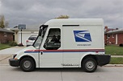
Dataset Description
US Wind Turbine database as a csv file
Created a new csv file of the 10 desired fields
Visual analysis shows that empty string fields in this file are populated with the word, “missing”. However, an analysis of the data in the 10 columns needed comes back with no missing data.
This study relies on each windfarm having a zip code. Windfarms with geocodes that failed the zip code lookup were assigned a value of ‘99999’.
Zillow Housing Data as a csv file
Noted constraint of only median-sale price data is available (desired average sales price as well)
Data initially looks clean, but that is because missing data is populated with NaN values
Analysis of NaN values shows that the years 2003 – 2013 have very high (over 50%) missing values. This may cause shift in analysis years from 2000 – 2010 to something more recent, i.e. 2014 – 2017
US Zipcode Database as a csv file
Used each windfarm’s geocode/s to identify the zipcode the windfarm resided in.
Merged US Zipcode database with Wind Turbine and Zillow Housing databases
This provided the additional fields of population density and median household income for each zip code.
The “expanded data file” now consists of windfarm, housing values, and zip code demographic data, keyed by zipcode.

Slide 5
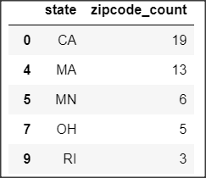
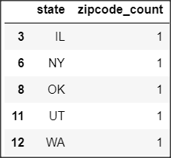
Exploring the Data (1 of 4)
Out of 1,269 zipcodes w/windfarms in the Windturbine database, only 20 zip codes meet all criteria for this study
Zillow only has median sales price data for 3,797 zipcodes out of 42,000 zipcodes in the US
Out of 1,269 zipcodes w/windfarms only 58 of these zip codes have Zillow housing data
Of these 58 zip codes, selected the top 5 states with the most windfarms (46 zip codes)
Of these 46 zip codes, there are only 20 zip codes twenty-five miles away without a windfarm that have Zillow housing data.
States with highest and lowest count of zip codes with windfarms…
Highest 5
Lowest 5
5

Slide 6
Exploring the Data (2 of 4)
Out of a possible 130 months (Mar-2008 thru Aug-2018) of housing data, at least 5 states have sufficient housing data…
0 months
65
130 months
CA
MA
MN
OH
RI
129
129
88
88
58

Slide 7
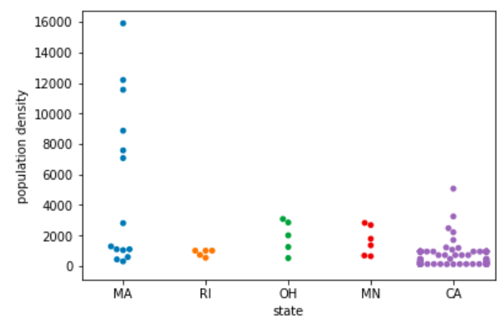
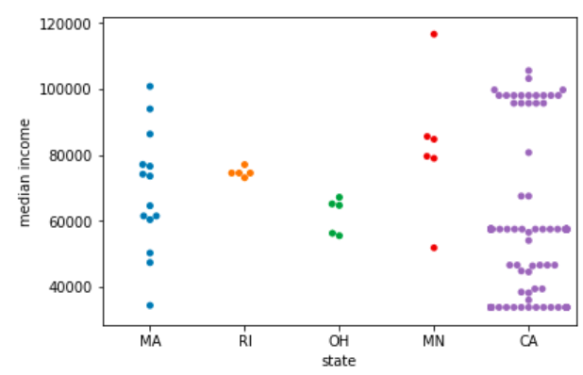
Exploring the Data (3 of 4)
MA has several windfarms in areas w/high population densities
CA has a number of windfarms in areas with a high median income
Population Density
Median Income

Slide 8
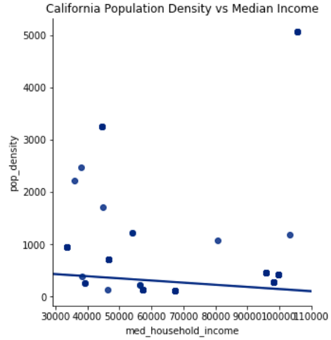
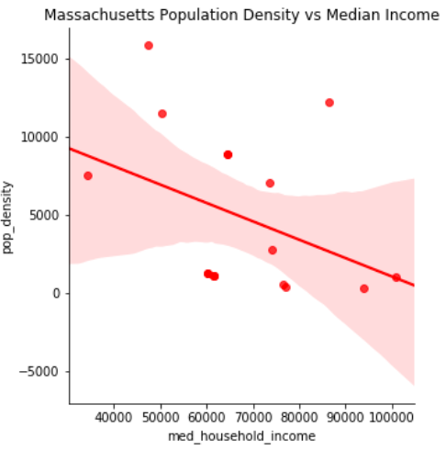
Exploring the Data (4 of 4)
California
Massachusetts
8

Slide 9
Statistics - Variables
Variables that appear most significant to answer this project’s question of…
“Do windfarms impact the value of home prices?”
Annual change in median home value (as a percentage) for zip codes with wind farms and zip codes 25 miles away without wind farms
Population density of zip codes with wind farms and adjoining or nearby zip codes without wind farms
Median income of zip codes with wind farms and adjoining or nearby zip codes without wind farms

Slide 10
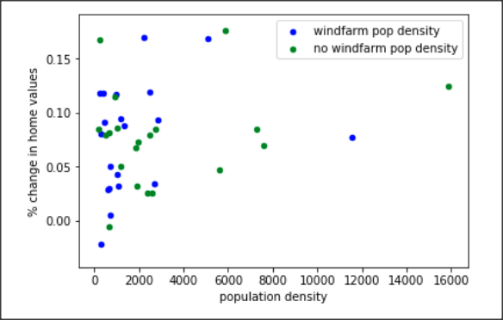
Statistics – Correlations (1 of 2)
The correlation coefficient between Population Density & Mean % Change in Home Values differs by only 2%
Correlation of zip codes with windfarms:
Correlation of zip codes without windfarms:
23%
25%

Slide 11
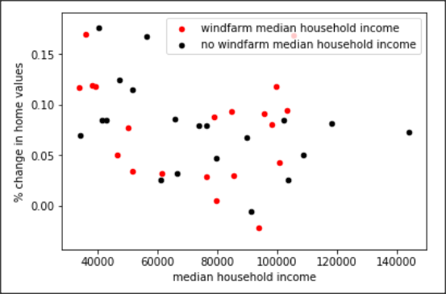
Statistics – Correlations (2 of 2)
The correlation coefficient between Median Income & Mean % Change in Home Values differs by 22%
Correlation of zip codes with windfarms:
Correlation of zip codes without windfarms:
19%
41%

Slide 12
Statistics - Significance
Using 2017 data, there is not a statistically significant difference in mean home values for zip codes with versus without windfarms
= $50,000
Mean home value for zip codes with windfarms
Mean home value for zip codes without windfarms
$360,000
$400,000
Difference:
$40,000
p-Value
Difference in value 95% confidence Interval
0.99
-$90,000 to $188,000

Slide 13
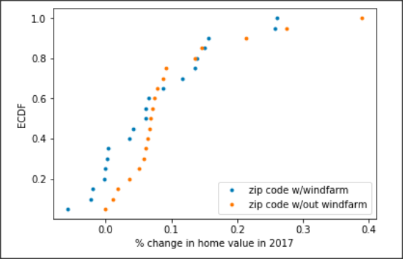
Statistics – ECDF’s
Continuing the use of 2017 data and creating ECDF’s reveals that outliers may cause the previously computed p-value and confidence interval to be misleading
To address this, when applying machine learning algorithms additional years beside 2017 should be used and removing outliers from the training data considered.

Slide 14
Summary
Objective
Build an algorithm that can be used to predict the change in value of a home based on proximity to windmills.
Observations:
Only around 2% (20/1269) of the zip codes with windfarms meet all criteria for this study. Though a small number this is sufficient sample data
The largest contributor to the drop in eligible zip codes is due to Zillow only having median-sale-price data for 3,297 zip codes out of 42,000 US zip codes
For the 20 zip codes, there is a very high percentage (75%) of housing data available for each month (2008–2018)
Population density does not appear to have a high impact on home values
Not surprisingly…
Windfarms are primarily in rural areas, though several zip codes with high populations and high median incomes host windfarms
Median income appears to have a significant impact on home values

